Slide 1
Hands-on MLFlow
Managing the end-to-end machine learning lifecycle in practice.
© 2022 SIT Academy AG | Heinrichstrasse 200, 8005 Zürich | https://sit.academy/
Notes:
__skip__

Slide 2
Toolkit
Python,
Google Colab,
Ngrok,
GitHub,
ML libraries: scikit-learn, Pandas, Numpy, Matplotlib
Notes:
__skip__

Slide 3
01
Introduction to MLFlow
The Data Science Project Life Cycle, and how MLFlow fits in it
Notes:
__skip__

Slide 4
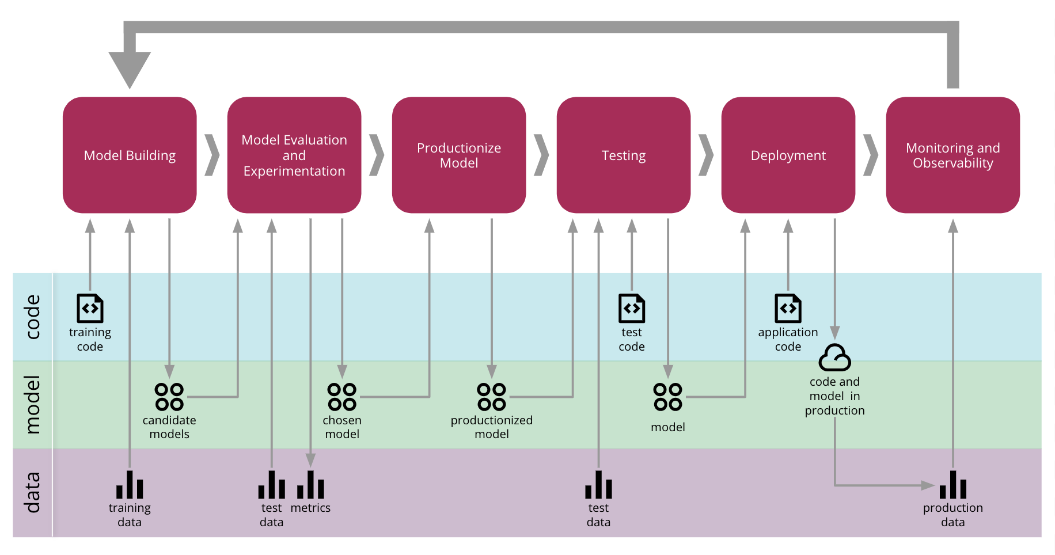
The Data Science Process
Source
Notes:
Productivity Challenges in Machine Learning
It is difficult to keep track of experiments
If you are just working with a script or notebook, how do you tell which data, code, and parameters went into getting a particular model result?

Slide 5
The Data Science Process
Source

Slide 6
Challenges of Machine Learning Development
Goal
Tools
= Optimizing metrics. Metrics can always be improved and can degrade if models are not updated.
Data Scientists use various tools/libraries for data preparation and modelling => experiment tracking and sharing is challenging.
Quality
Deployment
Depends on data, model, training parameters and code => we need to track all of these.
A same model might need to be deployed in various environments.

Slide 7
MLFlow Solutions
MLFlow Tracking
MLFlow Projects
MLFlow Models
MLFlow Registry
Record and query experiments: code, data, config, and results
Package data science code in a format to reproduce runs on any platform
Deploy machine learning models in diverse serving environments
Store, annotate, discover, and manage models in a central repository
Source
Notes:
From MLFlow’s documentation:
“MLflow Tracking is an API and UI for logging parameters, code versions, metrics, and artifacts when running your machine learning code and for later visualizing the results. You can use MLflow Tracking in any environment (for example, a standalone script or a notebook) to log results to local files or to a server, then compare multiple runs. Teams can also use it to compare results from different users.
MLflow Projects are a standard format for packaging reusable data science code. Each project is simply a directory with code or a Git repository, and uses a descriptor file or simply convention to specify its dependencies and how to run the code. For example, projects can contain a conda.yaml file for specifying a Python Conda environment. When you use the MLflow Tracking API in a Project, MLflow automatically remembers the project version (for example, Git commit) and any parameters. You can easily run existing MLflow Projects from GitHub or your own Git repository, and chain them into multi-step workflows.
MLflow Models offer a convention for packaging machine learning models in multiple flavors, and a variety of tools to help you deploy them. Each Model is saved as a directory containing arbitrary files and a descriptor file that lists several “flavors” the model can be used in. For example, a TensorFlow model can be loaded as a TensorFlow DAG, or as a Python function to apply to input data. MLflow provides tools to deploy many common model types to diverse platforms: for example, any model supporting the “Python function” flavor can be deployed to a Docker-based REST server, to cloud platforms such as Azure ML and AWS SageMaker, and as a user-defined function in Apache Spark for batch and streaming inference. If you output MLflow Models using the Tracking API, MLflow also automatically remembers which Project and run they came from.
MLflow Registry offers a centralized model store, set of APIs, and UI, to collaboratively manage the full lifecycle of an MLflow Model. It provides model lineage (which MLflow experiment and run produced the model), model versioning, stage transitions (for example from staging to production or archiving), and annotations.
”

Slide 8
Outline of the day
MLFlow Model Registry
MLFlow Projects
9:00-10:30
10:45-12:15
13:15-14:45
15:00-16:30
Introduction to MLFlow
&
MLFlow Tracking
MLFlow Models

Slide 9
02
MLFlow Tracking
log parameters, code versions, metrics, and artifacts when running your machine learning code.
Notes:
MLflow Tracking is an API and UI for logging:
parameters,
code versions,
metrics, and
artifacts
when running your machine learning code and for later visualizing the results. You can use MLflow Tracking in any environment (for example, a standalone script or a notebook) to log results to local files or to a server, then compare multiple runs. Teams can also use it to compare results from different users.

Slide 10
MLFlow Tracking Concepts
In MLFlow tracking, a run is the execution of some piece of data science code. For each run, you can log:
Code Version
Start & End Time
Source
Parameters
Metrics
Artifacts
Git commit hash of the run
Start and end Time of the run
Name of the file to launch the run, or the project name and entry point for the run
Key-value input parameters of your choice. Both keys and values are strings.
Key-value metrics, where the value is numeric and can be updated throughout the course of the run
Output files in any format (images, pickled models, data files…).
Source
Notes:
Artifacts.
Output files in any format.
For example, you can record images (for example, PNGs), models (for example, a pickled scikit-learn model), and data files (for example, a Parquet file) as artifacts. You can record runs using MLflow Python, R, Java, and REST APIs from anywhere you run your code.

Slide 11
MLFlow Tracking Python API
import numpy as np
from sklearn.linear_model import LinearRegression
import mlflow
X = np.array([[1, 1], [1, 2], [2, 2], [2, 3]])
y = np.dot(X, np.array([1, 2])) + 3
with mlflow.start_run():
mlflow.sklearn.autolog()
reg = LinearRegression().fit(X, y)
Creates a new run
Logs all parameters for LinearRegression
Logs training Metrics
Logs Model
By default, all this information is stored in the folder mlrun:
<experiment id>
├── <run id>
│ ├── artifacts
│ │ └── model
│ ├── meta.yaml
│ ├── metrics
│ ├── params
│ └── tags
└── meta.yaml
Notes:
More on Python API in MLFLow documentation:
https://www.mlflow.org/docs/latest/python_api/mlflow.sklearn.html#module-mlflow.sklearn

Slide 12
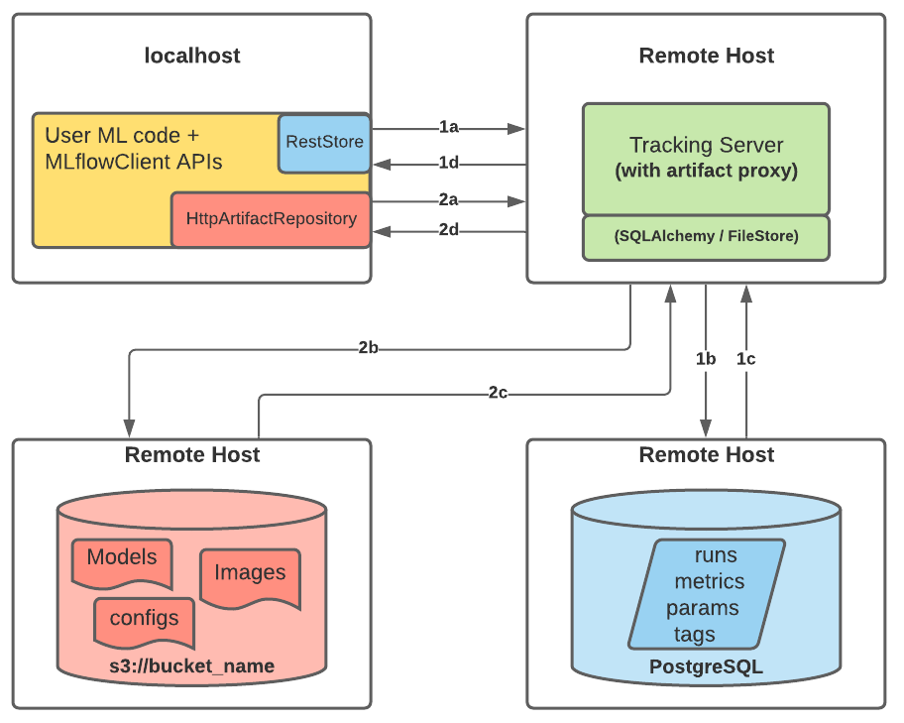
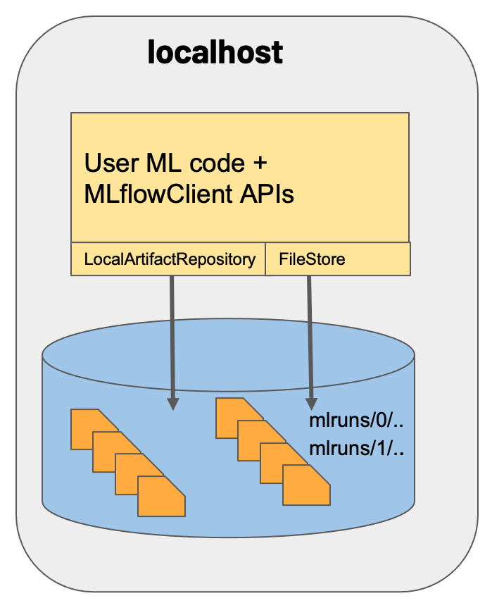
MLFlow Tracking Storage Configurations
Source
Notes:
MLFlow offers various possibilities to store the entities that they track (6 main scenarii).
Here are 2 end-members:
on the left is the default, local version, where all entities are simply saved in the folder called “mlruns”, in the active directory at the time of code execution.
on the right is a setup with a tracking server on AWS, that will store all artifacts (models, configs, images…) in a s3 bucket and all entities in a PostgreSQL database. Access to both is controlled by the tracking server.
Scenario 1: MLflow on localhost
Many developers run MLflow on their local machine, where both the backend and artifact store share a directory on the local filesystem—./mlruns—as shown in the diagram. The MLflow client directly interfaces with an instance of a FileStore and LocalArtifactRepository.
Scenario 5: MLflow Tracking Server enabled with proxied artifact storage access
MLflow’s Tracking Server supports utilizing the host as a proxy server for operations involving artifacts. Once configured with the appropriate access requirements, an administrator can start the tracking server to enable assumed-role operations involving the saving, loading, or listing of model artifacts, images, documents, and files. This eliminates the need to allow end users to have direct path access to a remote object store (e.g., s3, adls, gcs, hdfs) for artifact handling and eliminates the need for an end-user to provide access credentials to interact with an underlying object store.

Slide 13
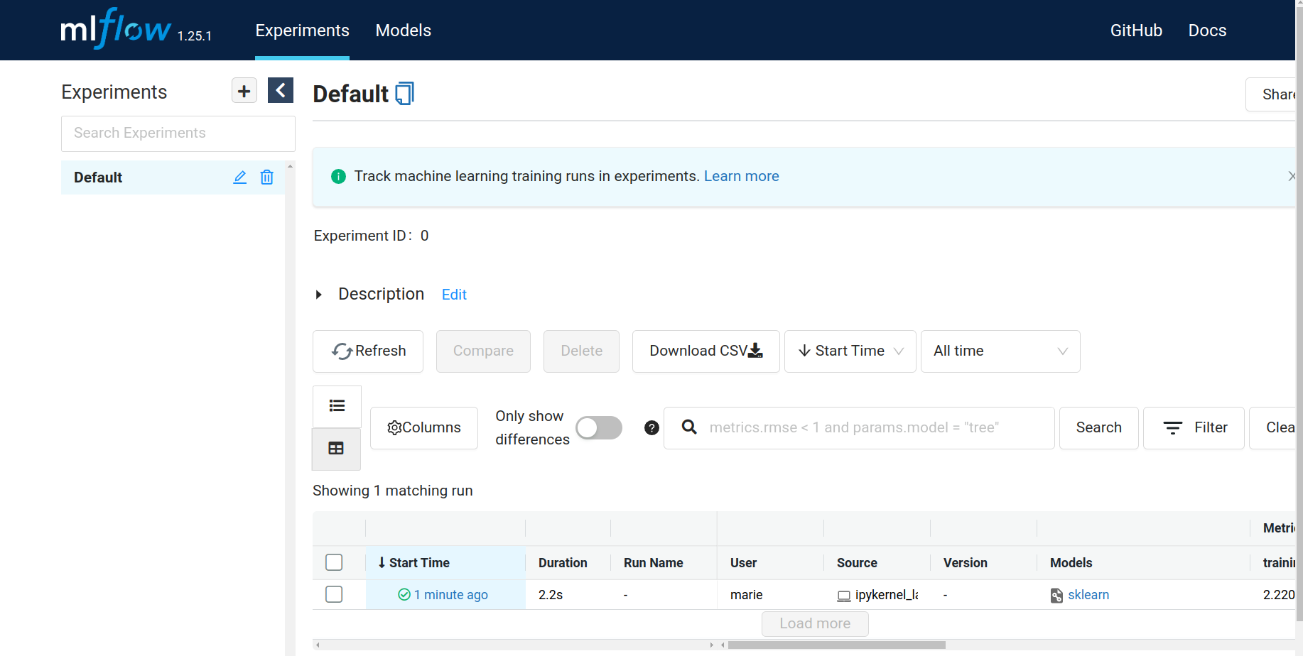
MLFlow Tracking UI
Once you have executed a run in MLFlow tracking, you can explore all the entities you logged using the MLFlow UI:
Source

Slide 14
MLFlow Tracking: experiments
Minimal Example
Regression problem
Classification Problem
Exercise: Tracking with your own code

Slide 15
Tracking Livecoding!
Go to Google Colab
The notebooks are available here:
LC0_MLFlow_Tracking_MinExample
LC1_MLFlow_Tracking_Regression_SwissHousing

Slide 16
03
MLFlow Projects
package data science code in a reusable way
Notes:
MLflow Projects are a standard format for packaging reusable data science code. Each project is simply a directory with code or a Git repository, and uses a descriptor file or simply convention to specify its dependencies and how to run the code. For example, projects can contain a conda.yaml file for specifying a Python Conda environment. When you use the MLflow Tracking API in a Project, MLflow automatically remembers the project version (for example, Git commit) and any parameters. You can easily run existing MLflow Projects from GitHub or your own Git repository, and chain them into multi-step workflows.

Slide 17
Overview
Concepts and motivation
Documentation
Build and share an MLflow Project with Git
Notes:
In this part 2, we will cover:
Concepts and motivation behind MLflow Projects and Models
Tour of the the MLflow Project and Model API Documentation
How to execute and reproduce MLflow Projects in the Databricks Community Edition (DCE)
Load PyFunc Model Flavor and score
Build an MLflow Project and share it for reproducible runs
Use the MLflow UI on the DCE

Slide 18
MLFlow Projects
Reproducibility
…and how to not become another statistic in the reproducibility crisis
MLFlow Projects
Package data science code in a format to reproduce runs on any platform

Slide 19
MLFlow Projects - Virtual environments
Reproducibility:
Data (processing methods)
Code (package versions, logging)
Other benefits:
Platform-agnostic
Automation
Troubleshooting

Slide 20


MLFlow Projects - Virtual environments
Reproducibility:
Code (package versions, logging)

Slide 21
MLFlow Projects - MLProject YAML file
MLProject.yaml
Entry points
Commands run within project
Need at least one!
Parameters
Variables to be passed to entry point
File paths, options, etc.
Environment
Conda, Docker, venv, etc.

Slide 22
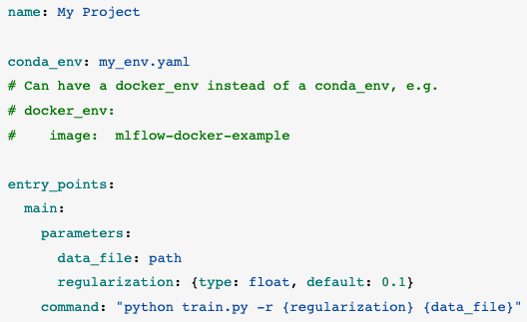
MLFlow Projects - MLProject YAML file
MLProject.yaml
Project name
Environment type
& config file
Final command to be run in terminal

Slide 23
Projects Livecoding!
Go to Google Colab
The notebook is available here: LC2_MLFlow_Projects_Regression_SwissHousing

Slide 24
04
MLFlow Models
Package Machine Learning Models and deploy them
Notes:
__skip__
MLflow Models offer a convention for packaging machine learning models in multiple flavors, and a variety of tools to help you deploy them. Each Model is saved as a directory containing arbitrary files and a descriptor file that lists several “flavors” the model can be used in. For example, a TensorFlow model can be loaded as a TensorFlow DAG, or as a Python function to apply to input data. MLflow provides tools to deploy many common model types to diverse platforms: for example, any model supporting the “Python function” flavor can be deployed to a Docker-based REST server, to cloud platforms such as Azure ML and AWS SageMaker, and as a user-defined function in Apache Spark for batch and streaming inference. If you output MLflow Models using the Tracking API, MLflow also automatically remembers which Project and run they came from.
In this part 2, we will cover:
Concepts and motivation behind MLflow Projects and Models
Tour of the the MLflow Project and Model API Documentation
How to execute and reproduce MLflow Projects in the Databricks Community Edition (DCE)
Load PyFunc Model Flavor and score
Build an MLflow Project and share it for reproducible runs
Use the MLflow UI on the DCE

Slide 25
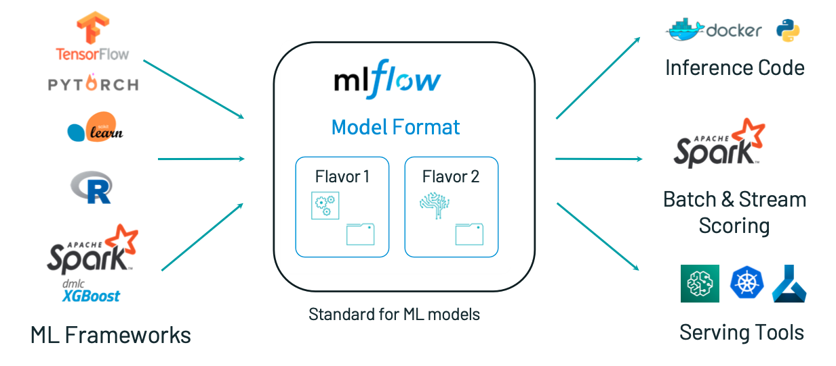
MLFlow Models Motivation:
Deploy machine learning models in diverse serving environments
Source
Notes:
Motivation behind Models is not different from what it was for Projects.
It was need to have all the MLFlow frameworks supported
—-
(Pytorch, Spark, Tensorflow, SKlearn, R) - ML Frameworks
(docker, Spark) - Serving tools
—-
because the whole proposition was that it wouldn’t be possible to have people use and combine the best tools available
and we won’t be able to serve them in different environments.
An MLflow Model is a standard format for packaging machine learning models that can be used in a variety of downstream tools—for example, real-time serving through a REST API or batch inference on Apache Spark. The format defines a convention that lets you save a model in different “flavors” that can be understood by different downstream tools.

Slide 26
MLFlow Models Documentation:
Deploy machine learning models in diverse serving environments
Storage Format, Model Flavors
Model API, Model Evaluation
Deployment Tools
Source
Notes:
Motivation behind Models is not different from what it was for Projects.
It was need to have all the MLFlow frameworks supported
—-
(Pytorch, Spark, Tensorflow, SKlearn, R) - ML Frameworks
(docker, Spark) - Serving tools
—-
because the whole proposition was that it wouldn’t be possible to have people use and combine the best tools available
and we won’t be able to serve them in different environments.
Problems:
models can’t be written with the wide range of tools, and as the result => you have to worry about how they are going to be used and executed in different env-s
these models can be written with different tools, i.e. I write model in TF and run it on Kubernetes, or run a Scikit-learn model and run on Spark, or write in Spark and run on Sagemaker as an MLLib.
So, If I want to support all that, then I happen to have all this NxM combination of Model Support for all the different serving tools.
Models can be understood as docker file for models.
if you have a DF you can execute any app.

Slide 27
Example MLFlow Model (option 1):
artifact_path: model
flavors:
python_function:
env: conda.yaml
loader_module: mlflow.sklearn
model_path: model.pkl
python_version: 3.7.13
sklearn:
code: null
pickled_model: model.pkl
serialization_format: cloudpickle
sklearn_version: 1.0.2
mlflow_version: 1.26.1
model_uuid: 07d32968a75345a9b28a8cd8f0b3f093
run_id: f5d7ac67f6454523a880adc52f72242b
utc_time_created: '2022-06-09 11:12:27.594199'
By default, all this information is stored in the folder model:
model/
├── MLmodel
├── model.pkl
├── conda.yaml
├── python_env.yaml
└── requirements.txt
Usable by:
Any tool that can
run Python (Docker, Spark,etc)
Tools that under-
stand Scikit-Learn model format
Built-In Model Flavors
Notes:
Each MLflow Model is a directory containing arbitrary files, together with an MLmodel file in the root of the directory that can define multiple flavors that the model can be viewed in.
Here we have an example where MLmodel file describes two flavors.
This model can then be used with any tool that supports either the sklearn or python_function model flavor. For example, the mlflow models serve command can serve a model with the python_function
mlflow models serve -m my_model

Slide 28



Model Scikit-Learn Flavor Example
mlflow.sklearn.log_model(pipeline_rf, "model")
Train a model
predict =
mlflow.pyfunc.load_model(...)
Flavor 1:
python_function
predict(pandas.input_dataframe)
model
format
model =
mlflow.sklearn.load_model(...)
Flavor 2:
sklearn
model.predict(data['X_test'])
Notes:
All PyFunc models will support pandas.DataFrame as input and DL PyFunc models will also support tensor inputs in the form of Dict[str, numpy.ndarray] (named tensors) and numpy.ndarrays (unnamed tensors).
Parameters
data – Model input as one of pandas.DataFrame, numpy.ndarray, scipy.sparse.(csc.csc_matrix | csr.csr_matrix), List[Any], or Dict[str, numpy.ndarray]
Returns
Model predictions as one of pandas.DataFrame, pandas.Series, numpy.ndarray or list.
Model Signature And Input Example
When working with ML models you often need to know some basic functional properties of the model at hand, such as “What inputs does it expect?” and “What output does it produce?”. MLflow models can include the following additional metadata about model inputs and outputs that can be used by downstream tooling:
Model Signature - description of a model’s inputs and outputs.
Model Input Example - example of a valid model input.
Model Signature
The Model signature defines the schema of a model’s inputs and outputs. Model inputs and outputs can be either column-based or tensor-based. Column-based inputs and outputs can be described as a sequence of (optionally) named columns with type specified as one of the MLflow data types. Tensor-based inputs and outputs can be described as a sequence of (optionally) named tensors with type specified as one of the numpy data types.
Model Input Example
Similar to model signatures, model inputs can be column-based (i.e DataFrames) or tensor-based (i.e numpy.ndarrays). A model input example provides an instance of a valid model input. Input examples are stored with the model as separate artifacts and are referenced in the the MLmodel file.
To include an input example with your model, add it to the appropriate log_model call, e.g. sklearn.log_model().

Slide 29
Model Scikit-Learn API and Evaluation
Examples:
Model API
Save and load MLflow Models in multiple ways:
1) mlflow.sklearn contains save_model, log_model, and load_model functions for scikit-learn models.
2) mlflow.models.Model class to create and write models.
import mlflow
import mlflow.sklearn
iris = load_iris()
sk_model = tree.DecisionTreeClassifier()
sk_model = sk_model.fit(iris.data, iris.target)
# set the artifact_path to location where experiment artifacts will be saved
…
# log model
mlflow.sklearn.log_model(sk_model, "sk_models")
Model Evaluation
mlflow.evaluate()* API to evaluate MLflow Model performance
*currently supports the python_function (pyfunc) model flavor for classification and regression tasks, evaluation results are logged to MLflow Tracking
with mlflow.start_run() as run:
model_info = mlflow.sklearn.log_model(model, "model")
result = mlflow.evaluate(
model_info.model_uri,
eval_data,
targets="label",
model_type="classifier",
dataset_name="adult",
evaluators=["default"],
)
Notes:
Model API
You can save and load MLflow Models in multiple ways. First, MLflow includes integrations with several common libraries. For example, mlflow.sklearn contains save_model, log_model, and load_model functions for scikit-learn models. Second, you can use the mlflow.models.Model class to create and write models. This class has four key functions:
add_flavor to add a flavor to the model. Each flavor has a string name and a dictionary of key-value attributes, where the values can be any object that can be serialized to YAML.
save to save the model to a local directory.
log to log the model as an artifact in the current run using MLflow Tracking.
load to load a model from a local directory or from an artifact in a previous run.
Model Evaluation
After building and training your MLflow Model, you can use the mlflow.evaluate() API to evaluate its performance on one or more datasets of your choosing. mlflow.evaluate() currently supports evaluation of MLflow Models with the python_function (pyfunc) model flavor for classification and regression tasks, computing a variety of task-specific performance metrics, model performance plots, and model explanations. Evaluation results are logged to MLflow Tracking.
The following example from the MLflow GitHub Repository uses mlflow.evaluate() to evaluate the performance of a classifier on the UCI Adult Data Set, logging a comprehensive collection of MLflow Metrics and Artifacts that provide insight into model performance and behavior:
Model Signature And Input Example
When working with ML models you often need to know some basic functional properties of the model at hand, such as “What inputs does it expect?” and “What output does it produce?”. MLflow models can include the following additional metadata about model inputs and outputs that can be used by downstream tooling:
Model Signature - description of a model’s inputs and outputs.
Model Input Example - example of a valid model input.
Model Signature
The Model signature defines the schema of a model’s inputs and outputs. Model inputs and outputs can be either column-based or tensor-based. Column-based inputs and outputs can be described as a sequence of (optionally) named columns with type specified as one of the MLflow data types. Tensor-based inputs and outputs can be described as a sequence of (optionally) named tensors with type specified as one of the numpy data types.
Model Input Example
Similar to model signatures, model inputs can be column-based (i.e DataFrames) or tensor-based (i.e numpy.ndarrays). A model input example provides an instance of a valid model input. Input examples are stored with the model as separate artifacts and are referenced in the the MLmodel file.
To include an input example with your model, add it to the appropriate log_model call, e.g. sklearn.log_model().

Slide 30
MLFlow Models Deployment:
Built-In Deployment Tools
on a local machine
to several production environments
Deploy MLflow models
Deploy a python_function model on Microsoft Azure ML
Deploy a python_function model on Amazon SageMaker
Export a python_function model as an Apache Spark UDF
Not all deployment methods are available for all model flavors.
Example:
Serve a model saved with MLflow.
Launch a webserver on the specified host and port. Supports models with the python_function or crate (R Function) flavor.
Make requests to POST /invocations in pandas split- or record-oriented formats.
$ mlflow models serve -m runs:/my-run-id/model-path &
$ curl http://127.0.0.1:5000/invocations -H 'Content-Type: application/json' -d '{
"columns": ["a", "b", "c"],
"data": [[1, 2, 3], [4, 5, 6]]
}'
Notes:
Built-In Deployment Tools
MLflow provides tools for deploying MLflow models on a local machine and to several production environments. Not all deployment methods are available for all model flavors.
In this section:
Deploy MLflow models
Deploy a python_function model on Microsoft Azure ML
Deploy a python_function model on Amazon SageMaker
Export a python_function model as an Apache Spark UDF
Deploy MLflow models
MLflow can deploy models locally as local REST API endpoints or to directly score files. In addition, MLflow can package models as self-contained Docker images with the REST API endpoint. The image can be used to safely deploy the model to various environments such as Kubernetes.
You deploy MLflow model locally or generate a Docker image using the CLI interface to the mlflow.models module.
The REST API server accepts the following data formats as POST input to the /invocations path:
JSON-serialized pandas DataFrames in the split orientation. For example, data = pandas_df.to_json(orient='split'). This format is specified using a Content-Type request header value of application/json or application/json; format=pandas-split.
JSON-serialized pandas DataFrames in the records orientation. We do not recommend using this format because it is not guaranteed to preserve column ordering. This format is specified using a Content-Type request header value of application/json; format=pandas-records.
CSV-serialized pandas DataFrames. For example, data = pandas_df.to_csv(). This format is specified using a Content-Type request header value of text/csv.
Tensor input formatted as described in TF Serving’s API docs where the provided inputs will be cast to Numpy arrays. This format is specified using a Content-Type request header value of application/json and the instances or inputs key in the request body dictionary.
serve
Serve a model saved with MLflow by launching a webserver on the specified host and port. The command supports models with the python_function or crate (R Function) flavor. For information about the input data formats accepted by the webserver, see the following documentation: https://www.mlflow.org/docs/latest/models.html#built-in-deployment-tools.
You can make requests to POST /invocations in pandas split- or record-oriented formats.
Example:
$ mlflow models serve -m runs:/my-run-id/model-path &
$ curl http://127.0.0.1:5000/invocations -H 'Content-Type: application/json' -d '{
"columns": ["a", "b", "c"],
"data": [[1, 2, 3], [4, 5, 6]]
}'

Slide 31
MLFlow Models Summary:
Packaging format for ML Models
• Any directory with MLmodel file
Defines dependencies for reproducibility
• Conda environment can be specified in MLmodel configuration
Model creation and loading utilities
• mlflow.<model_flavor>.save_model(...) or log_model(...)
• mlflow.<model_flavor>.load_model(...)
Deployment APIs
• CLI/Python/R/Java
• mlflow models [OPTIONS] COMMAND [ARGS]...
• mlflow models serve [OPTIONS [ARGS] ....
• mlflow models predict [OPTIONS [ARGS] ...

Slide 32
Models Livecoding!
Go to Google Colab
The notebooks are available here:
LC3_MLFlow_Models_Regression_SwissHousing
LC3_MLFlow_Models_Exe

Slide 33
05
MLFlow Model Registry
get familiar with the centralized model store
Notes:
__skip__

Slide 34

MLFlow Model Registry - Data Stores
Artifact store
Model files, plots, config files, etc.
(./mlruns, S3 bucket, etc.)
Backend store
Metrics, IDs, parameters, etc.
(Local file, SQL DB, etc.)

Slide 35
Artifact store
Model files, plots, config files, etc.
(./mlruns, S3 bucket, etc.)
Register different versions
(v.1, v.2, v.n)
Register different stages (staging, production, etc.)

Slide 36
MLFlow Model Registry - Model Store
Model management API
From the beginning to the end of a project
Full model lineage
Versioning, stage, MLFlow experiment metadata (run, date, metrics, etc.)
Higher level annotations
Easy accessibility for deployment

Slide 37
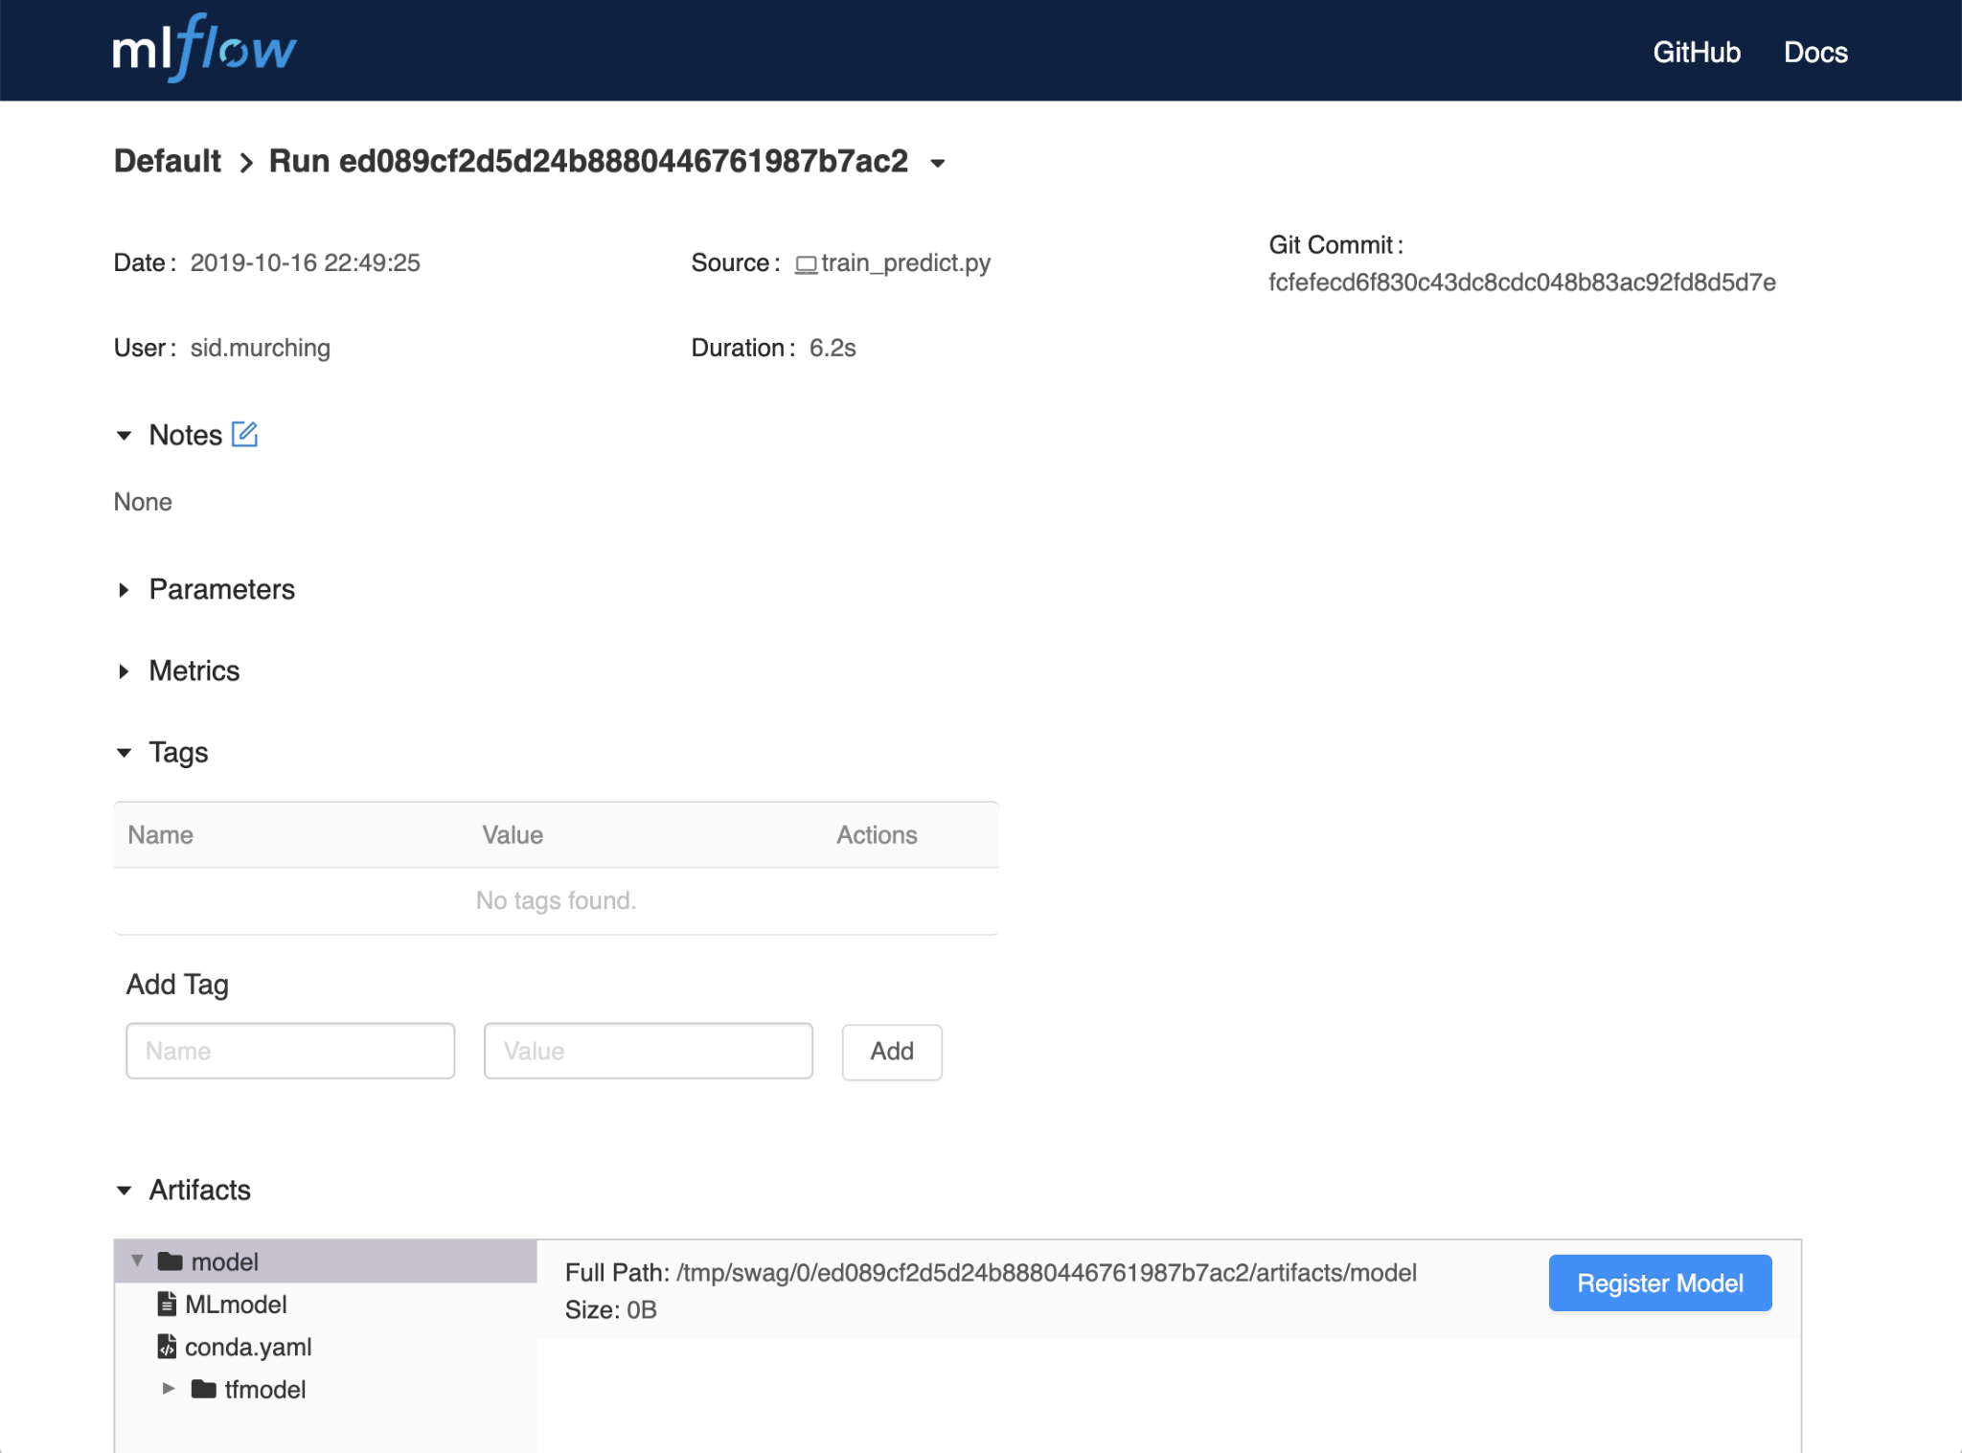

Slide 38
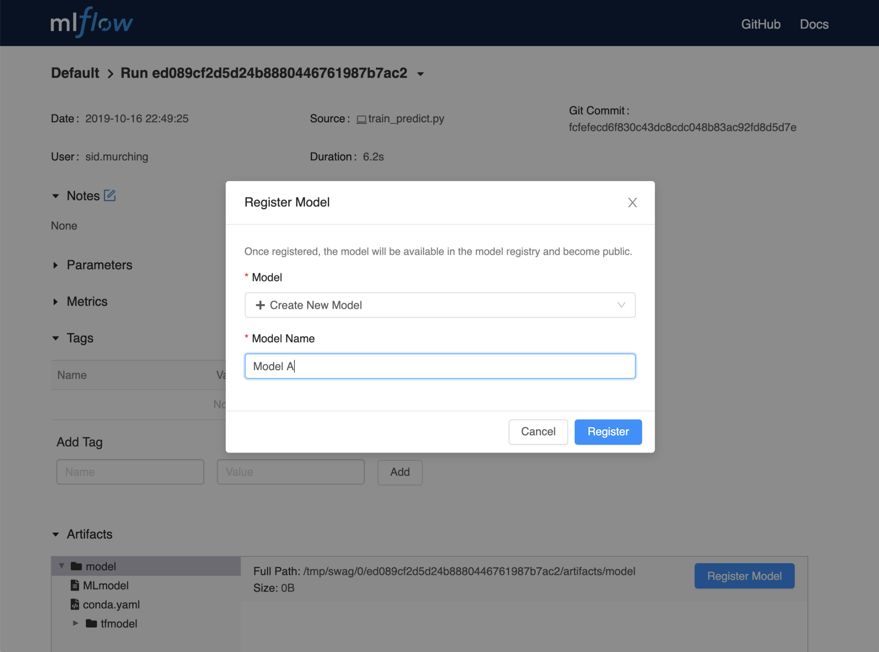

Slide 39
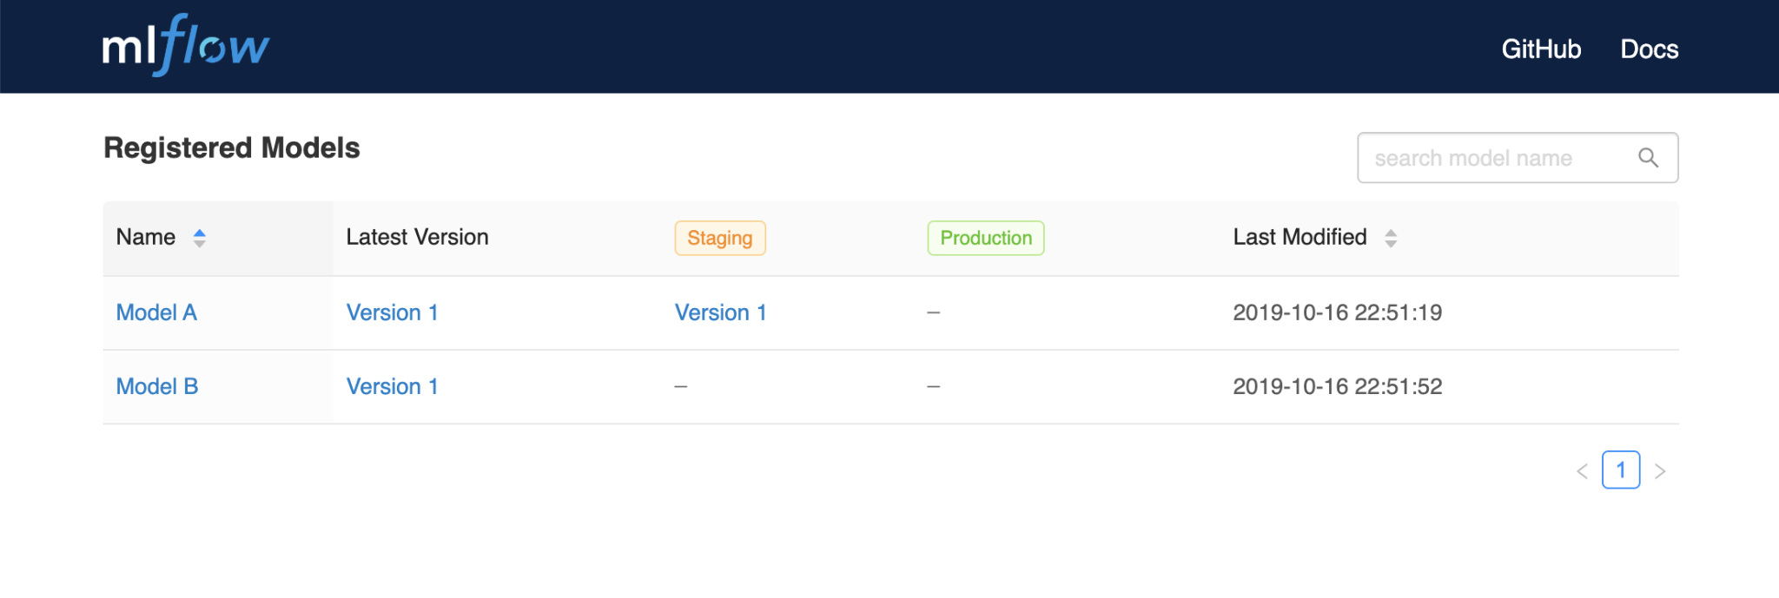

Slide 40
Registry Livecoding!
Storj.io
Remote tracking server
Run #1
Artifact store
Files & objects
S3 bucket
Backend store
Metadata
SQLite DB
This is you!

Slide 41
Registry Livecoding!
Go to Google Colab
The notebooks are available here:
LC4_MLFlow_Registry_Regression_SwissHousing

Slide 42
Sources and References
Continuous Delivery for Machine Learning
Databrick’s 3-part tutorial: Managing the Machine Learning Lifecycle using MLFlow
MLFlow’s official Documentation
Notes:
__skip__

Slide 43

Notes:
__skip__

